Slide 1
Multifactor Authentication and Banking

Slide 2
What is multifactor authentication (MFA)?
Something you know.
Something you have.
Something you are.
Notes:
MFA is an authentication method that combines two, or more, different factors to verify your identity. 2FA, 2 step auth.
Multiple uses of the same factor is NOT true MFA (IE: login and knowledge check) but is better than just one iteration of a single factor.
Something you now - Pin or Password, Pushed numbers, Knowledge check
Something you have - Specific Device (certificate), Token or Card, Digital Token/Application
Something you are - Facial Recognition, Fingerprint, Eye scan, hand shape/palm scanning, vascular scanning, typing gait
Potential fourth factor – location.

Slide 3
That one time Dilbert saw the future
Notes:
Time context - comic is old enough to vote.

Slide 4
How did we get here?
Computing power is cheap and passwords are dumb.
Humans have awful memories.
Password and data breaches.
Notes:
The population of the US in 2020 was 329.5Million with the Global number being 7.75Billion.
Self sustaining loop:
Password complexity – next slides. Passphrases better but still a problem.
Password reuse – Nord VPN Study, average internet active person has over 100 passwords. According to an Atlas VPN report from January 2022 nearly 6Billion unique credentials were leaked in 2021 alone. In another report that came out in 2022 from security firm SpyCloud they found that, based on the 1.7 billion username and password combinations it gathered from 755 leaked sources in 2021, nearly 64% of people used the same password exposed in one breach for other accounts.
Knowledge checks - In the 2015 OPM data breaches the background investigation records for 25.7Million people were exposed. In 2017 the Equifax data breach exposed the personal information of 147Million people (45% of the US). In the 2019 Verifications.io breach, 763M email addresses were exposed to include (Dates of birth, Email addresses, Employers, Genders, Geographic locations, IP addresses, Job titles, Names, Phone numbers, Physical addresses)
Nearly 1 in 10 people globally are likely to have had their information exposed by Verification.io.
So that's the bad. What about the good?
In 2017 Google required all 85,000+ of its employees to use MFA tokens. A year later not a single account had been compromised via a phishing attack. At RSACon in 2020 MSFT engineers announced 99.9% of compromised accounts don't use MFA.
Convenience (when properly implemented).

Slide 5
Notes:
Lower, Lower and upper, Alphanumeric, Alphanumeric + Special
5char – 12M, 380M, 916M, 2B
6char – 308M, 20B, 57B, 164B
Source - https://www.hivesystems.io/password

Slide 6
Where do we see MFA in the world today?
Banking\Medical\Sensitive sites and applications
Video Games
Computers/Mobile Devices
Notes:
It is common to find MFA in logins associated with sites that handles sensitive information such as banks and medical sites. Debit cards at ATMs function using MFA.
Video games have been adding authenticators to accounts for years. Account theft and sale became such a problem that Blizzard introduced authenticator fobs for WoW accounts in 2008. Same games have even gone as far as to reward the player with in game stuff just for having an authenticator attached to the account.
“Social Login” Sign in with Google, and others, will trigger MFA if you have it setup.
Windows Hello/biometrics on phones.

Slide 7
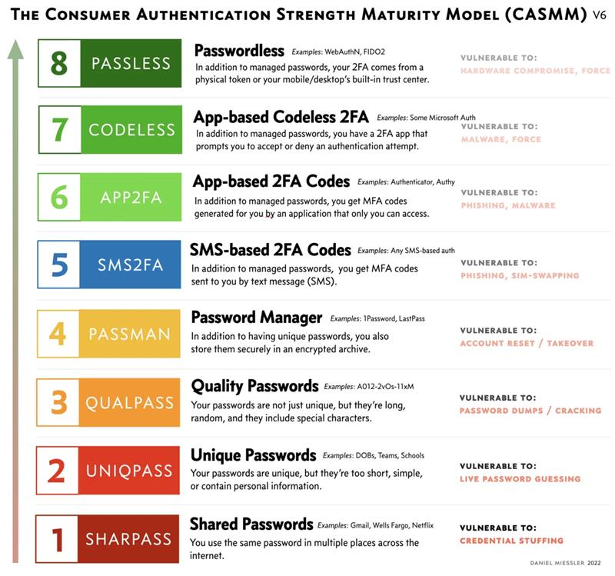
Miessler’s Hierarchy of Authentication
Notes:
Image - https://danielmiessler.com/p/not-all-mfa-is-equal-and-the-differences-matter-a-lot/ (2022)
Shout out to Carlos De Leon at DOR for sharing this!

Slide 8
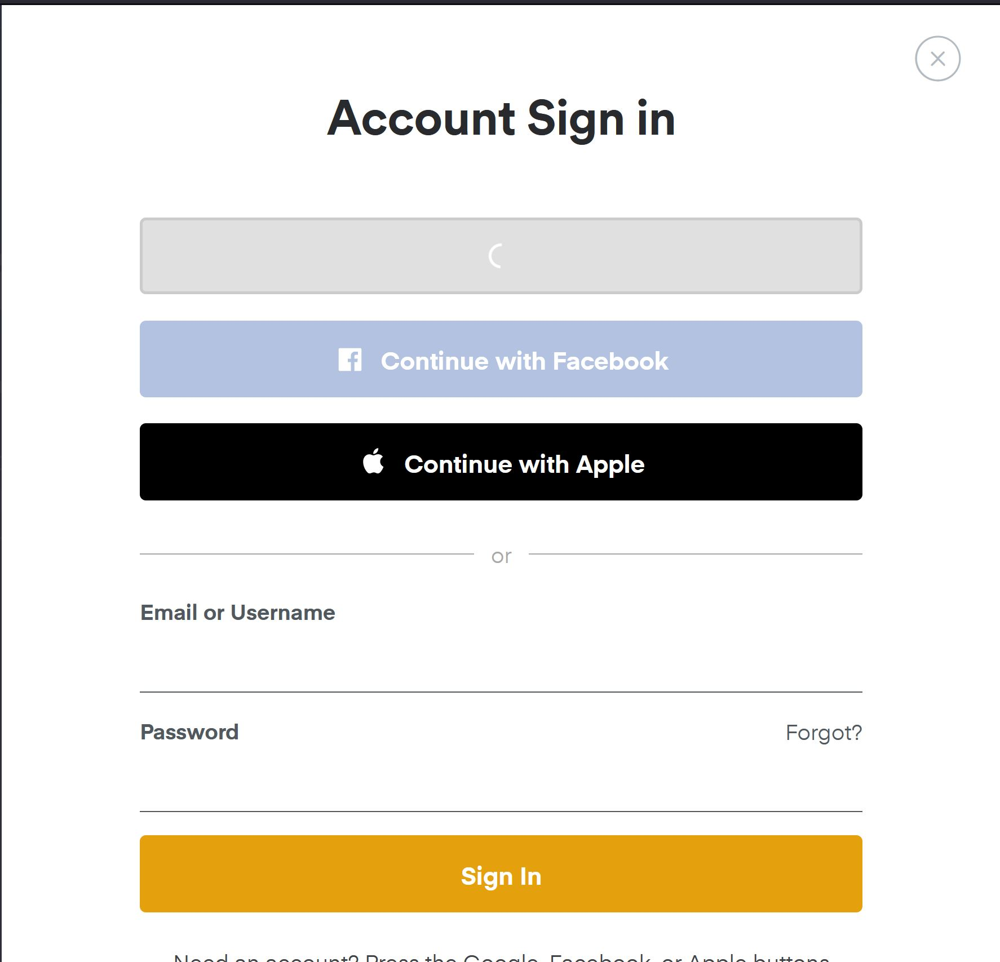
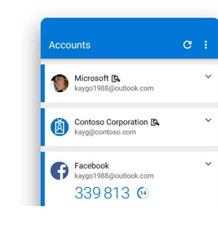
Notes:
Plex and Microsoft authenticator showing Temporary One Time Passwords (TOTP)

Slide 9
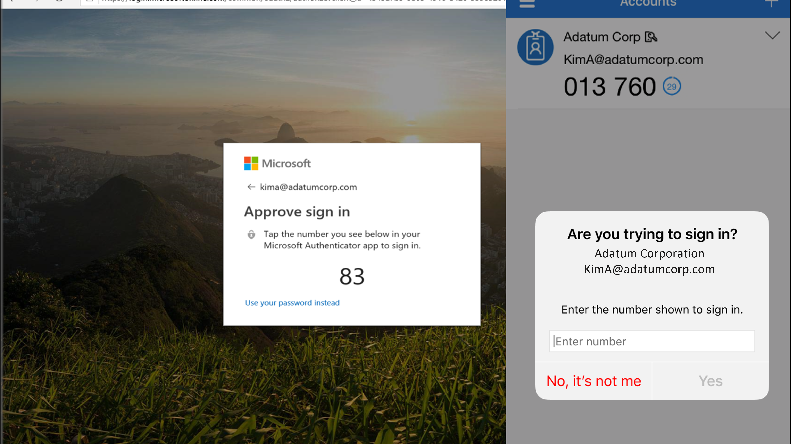
Notes:
Push notifications and number matching

Slide 10
Not quite flawless victory
Notification Fatigue
Impersonation/Cold Calls
Notes:
What is it? What do you do if you experience it?
Reporter at bar.
Some banks have stated they will not ask for your OTP.

Slide 11
Notes:
Creating Strong Passwords | BECU
New Mobile Resources: Features, Videos, FAQs | WSECU
Using Account Switcher | TwinStar Credit Union (twinstarcu.com)
Security Tools and Safety Precautions | Wells Fargo
KeyNavigator® Sign On | Key
Online & Mobile Banking | KeyBank
Advantages & Benefits of Online & Mobile Banking | KeyBank
Tools to Manage Your Security & Privacy Online (bankofamerica.com)

